Slide 1

P A S S W O R D
A U T H E N T I C A T E D
K E Y
E X C H A N G E
B Y
J U G G L I N G

Slide 2
PREPARED AND PRESENTED BY STUDENTS OF
M.Sc. Computer and Information Science 4th Semester of University of Science and Technology College, University of Calcutta
HIRAKJYOTI BANEERJEE
Roll No. – 91-CIS-091012
Registration No – 0007312 of 2006-2007
DIPENDU GHOSH
Roll No. – 91-CIS-091007
Registration No – 0000439 of 2006-2007
Under the Supervision of: Prof. DEVADATTA SINHA

Slide 3




Introduction

Slide 4
Introduction
Communication between a pair of users over a public unreliable channel with a secure session key.
e.g. SIGMA protocol used as the basis for the signature-based modes of the Internet Key Exchange (IKE) protocol
Password-Authenticated Key Exchange (PAKE) studies how to establish secure communication between two remote parties solely based on their shared password, without requiring a Public Key Infrastructure (PKI).
Passwords are low-entropy secrets, and subject to dictionary attacks.
To protected during transmission password is sent by the widely deployed method known as SSL/TLS.
Drawback of using SSL/TLS is that it is subject to man-in-the-middle attacks.
Cryptographically secure private keys was adopted by the UK National Grid Service (NGS) to authenticate users.
Researchers have been actively exploring ways to perform password-based authentication without using PKIs or certificates – a research subject called the Password-Authenticated Key Exchange (PAKE).

Slide 5
Password authenticated key exchange (PAKE)
Two forms of PAKE are Balanced and Augmented methods.
Balanced PAKE allows parties that use the same password to negotiate and authenticate a shared key.
Examples of Balanced PAKE are:
Encrypted Key Exchange(EKE)
PAK and PPK
SPEKE (Simple password exponential key exchange)
J-PAKE (Password Authenticated Key Exchange by Juggling)
Augmented PAKE is a variation applicable to client/server scenarios, in which an attacker must perform a successful brute-force attack in order to masquerade as the client using stolen server data.
Examples of Augmented PAKE :
AMP
Augmented-EKE
B-SPEKE
PAK-Z
SRP

Slide 6
DIFFIE- HELLMAN KEY
EXCHANGE

Slide 7
DIFFIE- HELLMAN KEY EXCHANGE
The first published public-key algorithm appeared in the seminal paper by Diffie and Hellman that defined public-key cryptography and is generally referred to as Diffie-Hellman Key Exchange.
The purpose of this algorithm is to enable two users to securely exchange a key that can be used for subsequent encryption of messages.
The Diffie-Hellman algorithm depends for its effectiveness on the difficulty of computing discrete logarithms.
First we define a primitive root of a prime number p as one whose power modulo p generates all integers from 1 to p-1.

Slide 8
DIFFIE- HELLMAN KEY EXCHANGE (contd.)
If a is a primitive root of a prime number p then the numbers
a mod p, a² mod p,……, a^{p-1} mod p
are distinct and consists of integers 1 through p-1 in some permutation.
For any integer b and a prime root a of prime number p, we can find a unique exponent i such that
b = a^{i} mod p where 0 ≤ i ≤ (p-1)
The exponent i is referred to as the discrete logarithm of b for the base a, mod p.
Diffie–Hellman establishes a shared secret that can be used for secret communications by exchanging data over a public network.

Slide 9
DIFFIE- HELLMAN KEY EXCHANGE (contd.) Description
Alice and Bob agree on a finite cyclic group G and a generating element g in G (This is usually done long before the rest of the protocol; g is assumed to be known by all the attackers). We will write the group G multiplicatively.
Alice picks a random natural number a and sends gª to Bob.
Bob picks a random natural number b and sends g^{b} to Alice.
Alice computes (g^{b})ª.
Bob computes (gª)^{b}.
Both Alice and Bob are now in possession of the group element g^{ab}, which can serve as the shared secret key. The values of (g^{b})ª and (gª)^{b} are the same because groups are power associative.

Slide 10
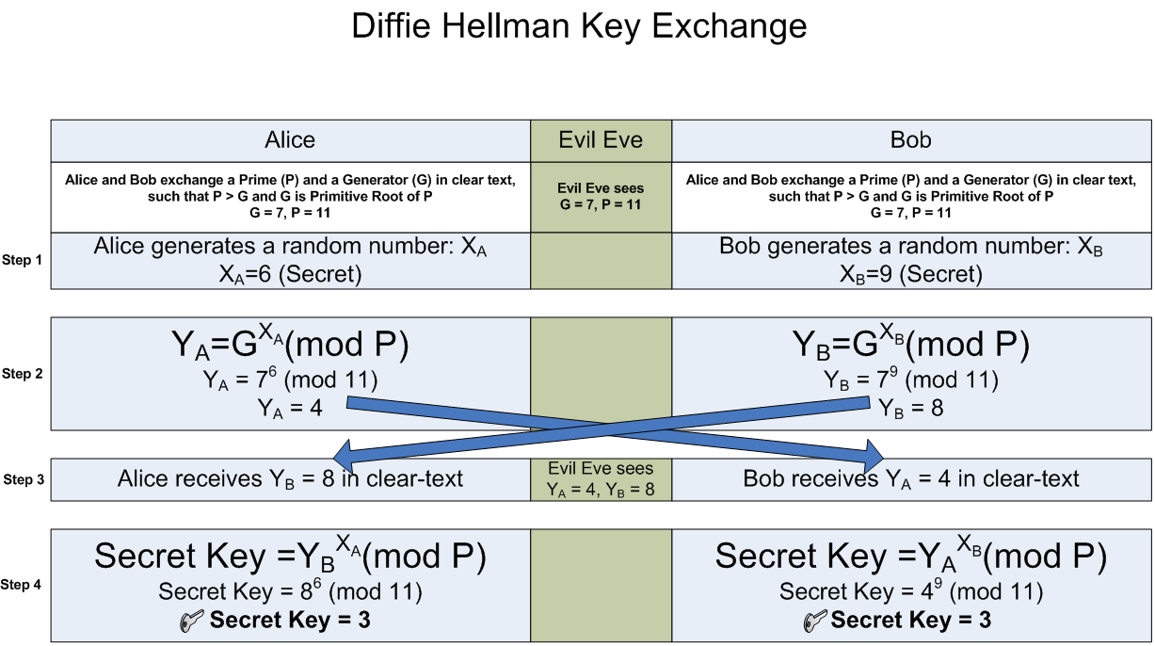
DIFFIE- HELLMAN KEY EXCHANGE (contd.) Description

Slide 11
DIFFIE- HELLMAN KEY EXCHANGE (contd.) Algorithm
Two publicly known numbers:
a prime number p
an integer g that is a primitive root of p
User A selects a random integer X_{A} < p and computes Y_{A} = g ^{XA} mod p
User B selects a random integer X_{B} < p and computes Y_{B} = g ^{XB} mod p
Each side keeps the X values private and makes Y value available publicly to the other side
User A computes K = (Y_{B}) ^{XA} mod p
User B computes K = (Y_{A}) ^{XB} mod p
These two calculations produce the same results

Slide 12
DIFFIE- HELLMAN KEY EXCHANGE (contd.) Man-in-the-Middle Attack
The Diffie-Hellman algorithm is insecure against the man-in-the-middle attack.
The attack proceeds as follows:
User X prepares for attack by generating two random private keys c and d and compute corresponding public keys X_{C} = g^{c} mod p and X_{D} = g^{d} mod p.
User A transmits A to User B.
User X intercepts A and transmits X_{C} to User B. User X then also calculates S_{A} = (A)^{d} mod p.
User B receives X_{C} and calculates S_{B} = (X_{C})^{b} mod p.
User B transmits B to User A.
User X intercepts B and transmits X_{D} to User A. User X then also calculates S_{B} = (B)^{c} mod p.
User A receives X_{D} and calculates S_{A} = (X_{D})ª mod p.
At this point User B and User A think that they share a secret key, but instead User B and User X share key S_{B} and User A and User X share secret key S_{A.} Thus if User X wants then he can eavesdrop the conversation without altering it or he can modify the message going from User A to User B and vice versa.

Slide 13
MODEL OF THE NETWORK FOR KEY EXCHANGE
We assume the key exchange is carried out over an unsecured network.
The security requirements that a PAKE protocol should fulfill.
Off-line dictionary attack resistance
Forward secrecy
Known-key
On-line dictionary attack resistance
The scheme discussed here is a balanced Password Authenticated Key Exchange Scheme which is Password Authenticated Key Exchange by Juggling (J-PAKE).

Slide 14
PASSWORD
AUTHETICATED
KEY
EXCHANGE
BY JUGGLING

Slide 15
PASSWORD AUTHETICATED KEY EXCHANGE BY JUGGLING
In cryptography, the Password Authenticated Key Exchange by Juggling (or J-PAKE) is a password-authenticated key agreement protocol.
Password-authenticated key agreement generally encompasses methods such as:
Balanced password-authenticated key exchange
Augmented password-authenticated key exchange
Password-authenticated key retrieval
Multi-server methods
Multi-party methods
J-PAKE achieves the mutual authentication in two steps
Two parties send ephemeral public keys to each other
They encrypt the shared password by juggling the public keys in a verifiable way

Slide 16
PASSWORD AUTHETICATED KEY EXCHANGE BY JUGGLING
(contd.) Algorithm
Alice selects two secret values x₁ and x₂ at random : x₁ ЄR Z_{q} and x₂ ЄR Z_{q}*.
Bob selects two secret values x₃ and x₄ at random : x₃ ЄR Z_{q} and x₄ ЄR Z_{q}*.
q is prime.
Step 1: Alice sends out g^{x1}, g^{x2} and knowledge proofs for x1 and x2. Similarly, Bob sends out g^{x3}, g^{x4} and knowledge proofs for x3 and x4.
When this step finishes, Alice and Bob verify the received knowledge proofs, and also check g^{x2}, g^{x4} ≠ 1.
Step 2: Alice sends out A = g^{(x1+x3+x4).x2.s} and a knowledge proof for x2.s. Similarly, Bob sends out B =g^{(x1+x2+x3).x4.s} and a knowledge proof for x4.s.
When this step finishes, Alice computes K = (B/g^{x2.x4.s})^{x2} = g^{(x1+x3).x2.x4.s}, and Bob computes K = (A/g^{x2.x4.s})^{x4} = g^{(x1+x3).x2.x4.s}.

Slide 17
PASSWORD AUTHETICATED KEY EXCHANGE BY JUGGLING
(contd.) Security Analysis
Case 1:- Under the Discrete Logarithm (DL) assumption, Bob cannot compute (x1 + x3 + x4).
Case 2:- Under the Decision Diffie-Hellman (DDH) assumption, Bob cannot distinguish Alice’s cipher text A =g^{(x1+x3+x4) ·x2·s} from a random element in the group.
Case 3:- (Off-line dictionary attack resistance) Under the DDH assumption, the cipher texts A = g^{(x1+x3+x4) ·x2·s} and B = g^{(x1+x2+x3) ·x4·s} do not leak any information for password verification.
Case 4:- (Forward secrecy) The past session keys derived from the protocol remain secure even when the secret s is later disclosed.
Case 5:- (On-line dictionary attack resistance) An active attacker cannot compute the session key if he chose a value s’≠ s.

Slide 18
Implementation

Slide 19
SOFTWARES USED FOR IMPLEMENTATION
O.S. : Mandriva Linux 2010
C compiler: gcc compiler of Linux

Slide 20
DIFFIE- HELLMAN KEY EXCHANGE Implementation
Suppose user A and user Bob wants to interact among each other.
Three main functions are used:-
user_a():
Enters private key ‘a’
Generates public key ‘A’
Generates common private key ‘S_{A}’
user_b():
Enters private key ‘b’
Generates public key ‘B’
Generates common private key ‘S_{B}’
attacker(): poses as user A to user B and user B to user A

Slide 21
PASSWORD AUTHETICATED KEY EXCHANGE BY JUGGLING Implementation
Suppose user Alice and Bob wants to interact among each other.
genrand():
Generates the shared key ‘Secret’ and both users keep them using.
genknp(&user) :
Selects secret values x₁ and x₂ for Alice
Selects secret values x₃ and x₄ for Bob
Where x₁,x₃ Є_{R} Z_{q} and x₂,x₄ Є_{R} Z*_{q} and x₂,x₄ ≠ 0.

Slide 22
PASSWORD AUTHETICATED KEY EXCHANGE BY JUGGLING (contd.) Implementation
sendstep1 (&from, &to, &param) :
Alice sends g^{x1}, g^{x2} and knowledge proofs for x₁ and x₂.
Bob sends g^{x3}, g^{x4} and knowledge proofs for x₃ and x₄.
verifysendstep1 (&from,&to,&param) :
Verifies the received knowledge proofs, and also checks g^{x2} , g^{x4} ≠ 1 , for Alice and Bob.
sendstep2 (&from, &to, &param):
Alice sends A=g^{(x1+x3+x4)*x2*secret} and knowledge proof x₂*secret.
Bob sends B=g^{(x1+x2+x3)*x4*secret} and knowledge proof for x₄*secret.
verifysendstep2 (&from,&to,&param):
Verifies the received knowledge proofs the received knowledge proofs of Alice and Bob.

Slide 23
PASSWORD AUTHETICATED KEY EXCHANGE BY JUGGLING Implementation (contd.)
compute_key (&user, &param):
Computes K=(B/g^{x2*x4*secret})^{x2}= g^{(x1+x3)*x2*x4·secret} for Alice
Computes K=(A/g^{x2*x4*secret})^{x4}= g^{(x1+x3)*x2*x4·secret} for Bob.
hashing(struct JPakeUser *user):
Performs hashing on the computed keys for the users and maps them in the hash table.

Slide 24
PASSWORD AUTHETICATED KEY EXCHANGE BY JUGGLING Implementation (contd.)
The Following three functions are requird to calculate the knowledge proofs and verifing the sent knowledge proofs:
zkp (from, to, param, step number):
Invokes prover for calculating the knowlwdge proofs.
Invokes verifier for verifing the received knowlwdge proofs.
prover (from, to, param, step number, variable order):
Generates a random number ‘r’ called the commitment and calculates t=g^{r}
Receives a random number ‘c’ called the challenge from verifier.
Sends s=r + c * x
verifier(u,step number,variable order,generator,commitment,challenge,s,x) :
Verifies the sent knowledge proofs by checking if g^{s} = t*y^{c}

Slide 25
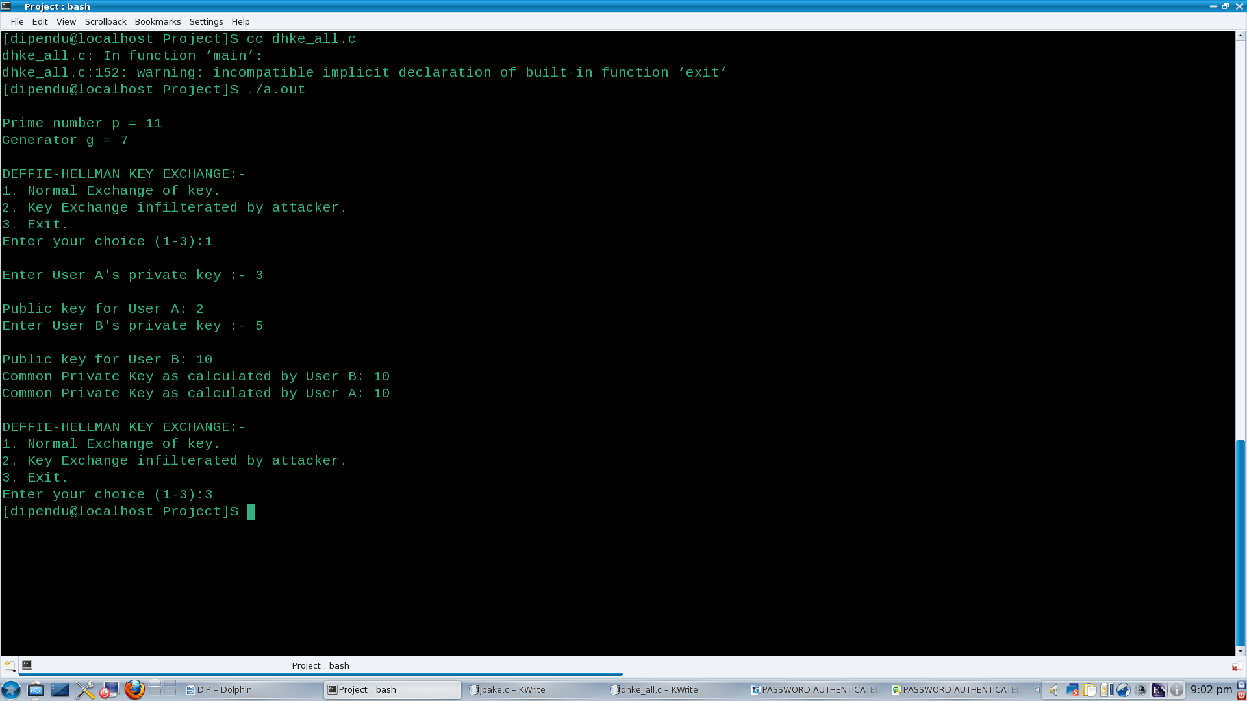
OUTPUTS

Slide 26
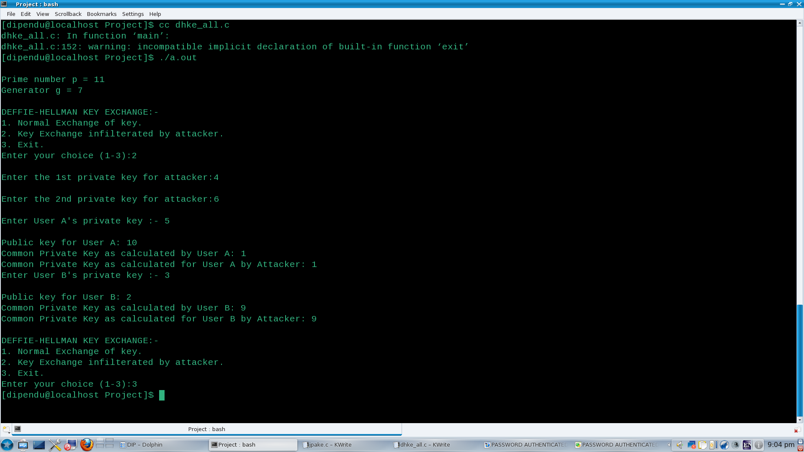
OUTPUTS

Slide 27
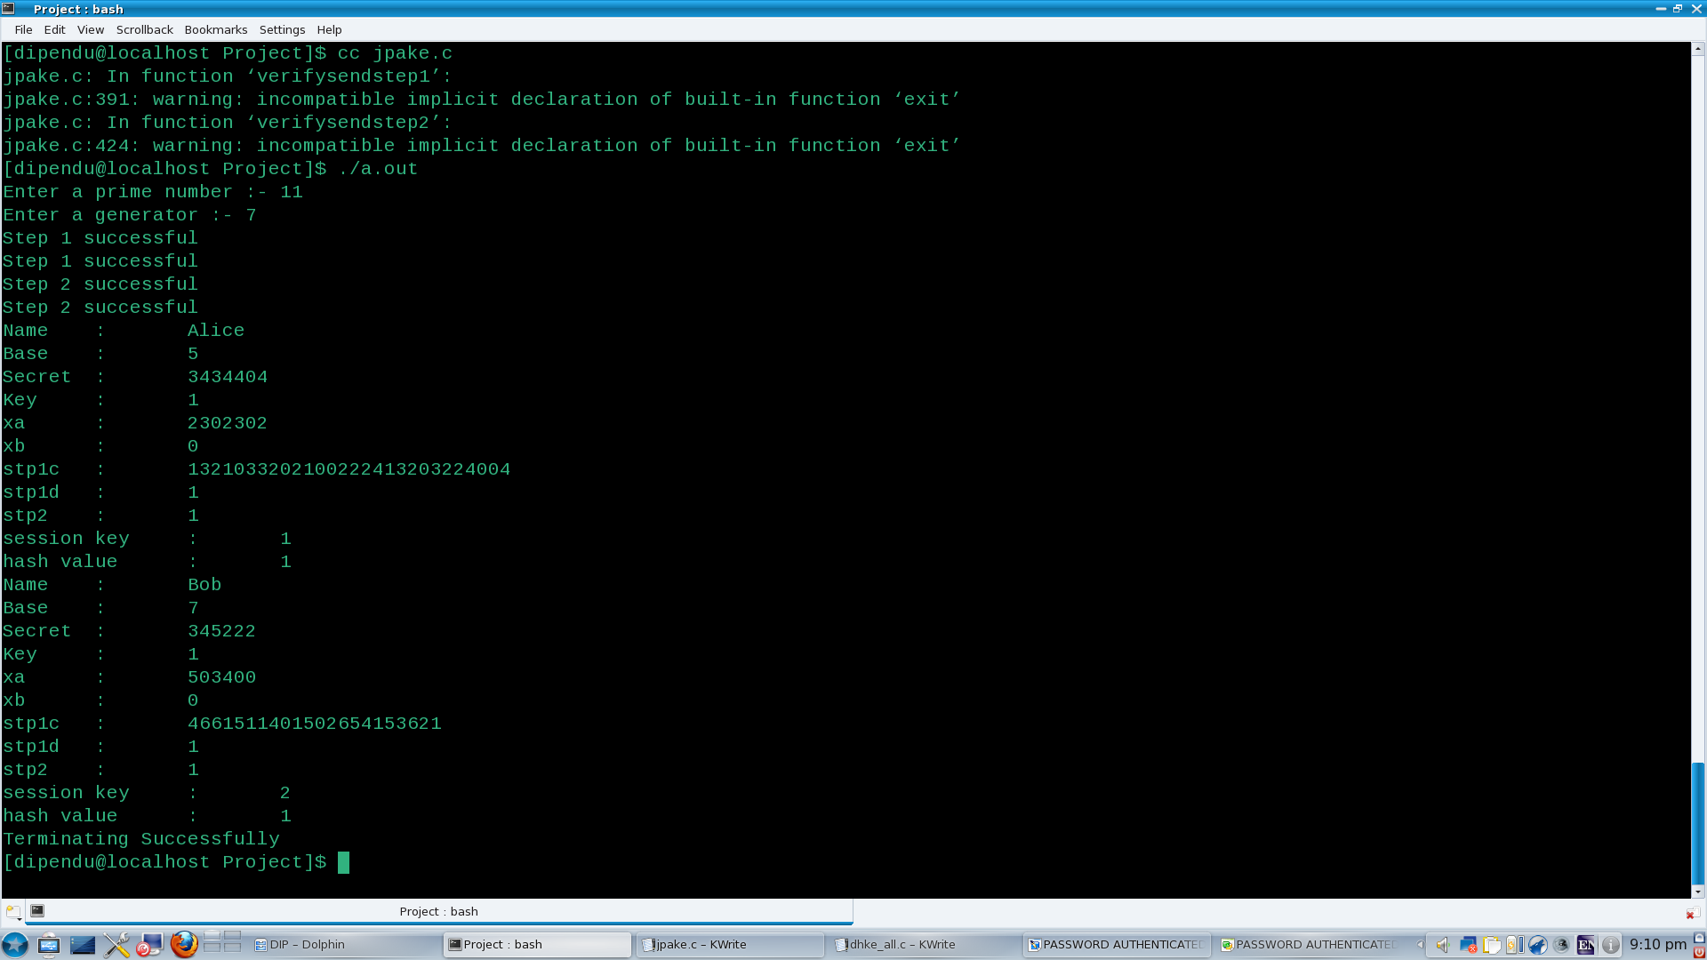
OUTPUTS

Slide 28
CONCLUSION

Slide 29
FUTURE SCOPE
Here we have programmed only a simulated environment. So we didn’t compute keys which have huge number of digits.
In future we need to implement password authenticated key exchange by juggling in a real-world networked environment.
We also need to show by implementing certain cases that a network with J-PAKE implemented on it is secure against an attacker.

Slide 30
REFERENCES
Simple Password-Based Encrypted Key Exchange Protocols
By Michel Abdalla and David Pointcheval
Password Authenticated Key Exchange by Juggling
By Feng Hao from Center for Computational Science, University College London
And Peter Ryan from School Of Computing Science, University of Newcastle upon Tyne
Cryptography and Network Security Principles and Practices, 4th Ed
By William Stallings
http://en.wikipedia.org/wiki/Schnorr_signature
http://en.wikipedia.org/wiki/Diffie-Hellman_key_exchange
http://en.wikipedia.org/wiki/Schnorr_group
http://en.wikipedia.org/wiki/Cyclic_group
http://en.wikipedia.org/wiki/Proof_of_knowledge
http://en.wikipedia.org/wiki/PAKE
http://en.wikipedia.org/wiki/J-PAKE
http://www.lix.polytechnique.fr/~liberti/public/computing/prog/c/C/FUNCTIONS/rand.html
http://www.dreamincode.net/forums/topic/12660-use-of-rand-function/
http://pubs.opengroup.org/onlinepubs/009695399/functions/rand.html

Slide 31
ACKNOWLEDGEMENT
Our sincere thanks to :
Prof. Devadatta Sinha (Project Guide),
Department of Computer Science and Engineering,
University College of Science and Technology ,
University of Calcutta
Prof.Nabendu Chaki,
Chairman,
Board of Post Graduate Studies,
Department of Computer Science and Engineering, University College of Science and Technology,
University of Calcutta
Library of Department of Computer Science and Engineering, University College of Science and Technology,
University of Calcutta

Slide 32
THANK YOU !

